Slide 1
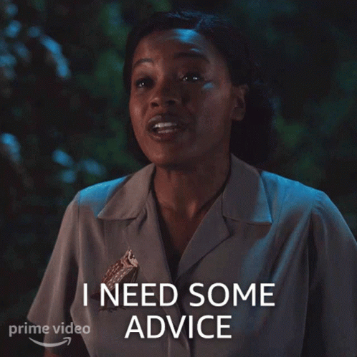
Advise =
verb
Advices (pl)
Advice = noun

Slide 2

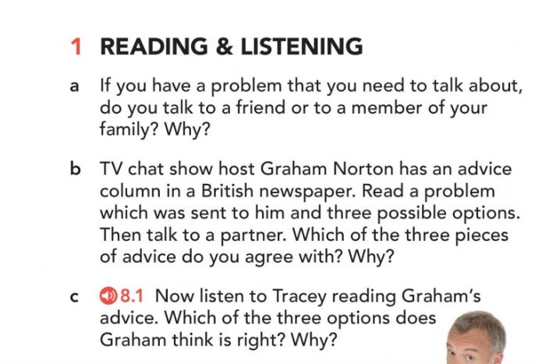
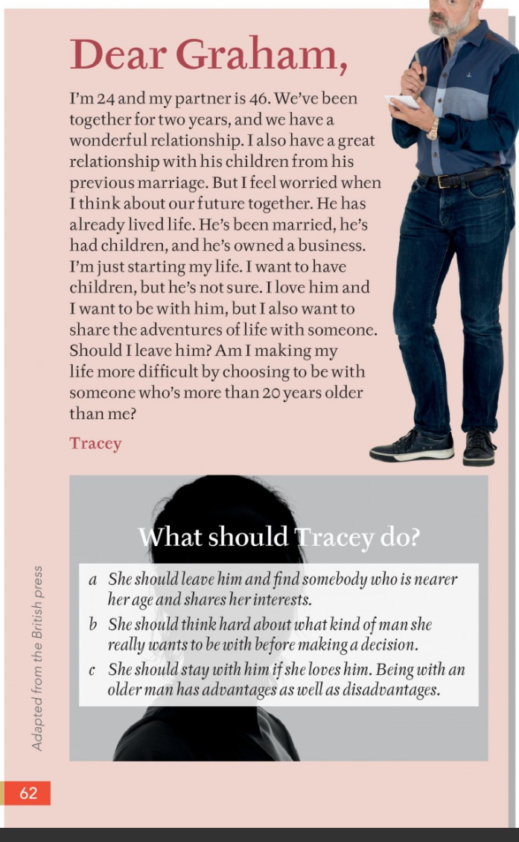

Slide 4
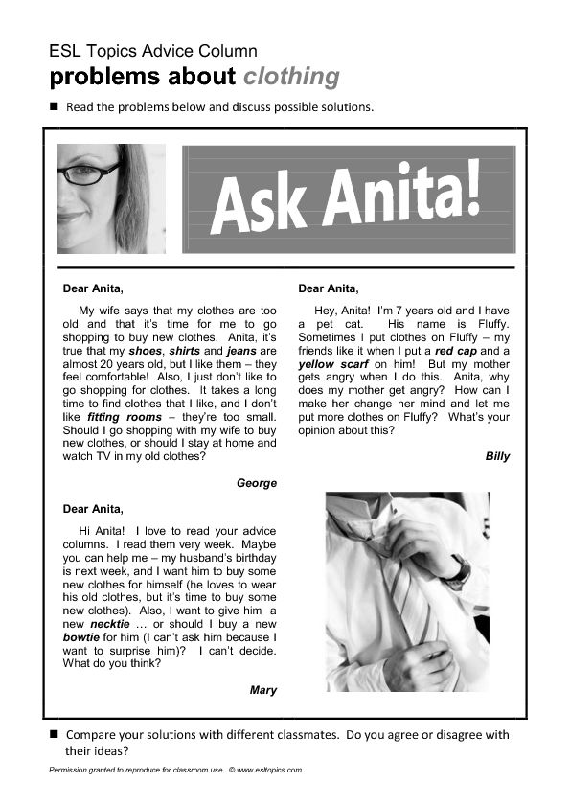
Advice column = ?
an article in a newspaper/magazine that offers advice to people who write to ask for help with a problem.

Slide 5
*previous =
past
*wonderful (adj) =
amazing/great
*to live (v) life =
to enjoy life
*adventure(n)=
exciting situations in life (She had some exciting adventures in Italy.

Slide 6

*to leave (v) someone =

Slide 7

*to share (v)=

Slide 8
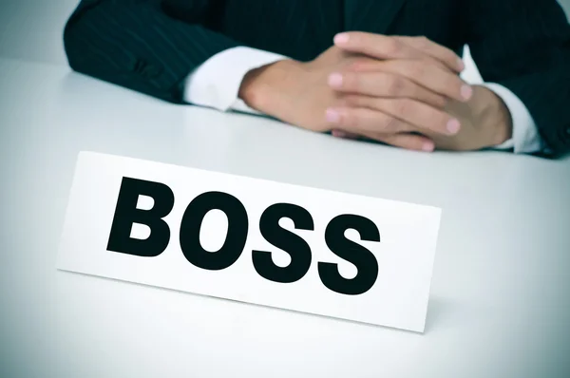
*to own (v) a business

Slide 9
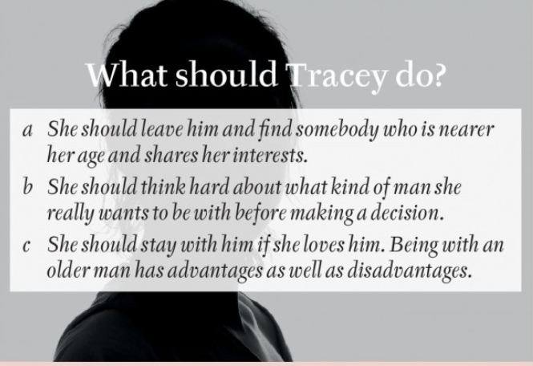
Choose what you think is the best advice between a, b or c.
Talk to your partner.

Slide 11
ANSWER:
b: She should think hard about what kind of man she really wants to be with before making a decision.

Slide 12
Listen again with the script.
Any vocabulary you don’t understand?

Slide 13
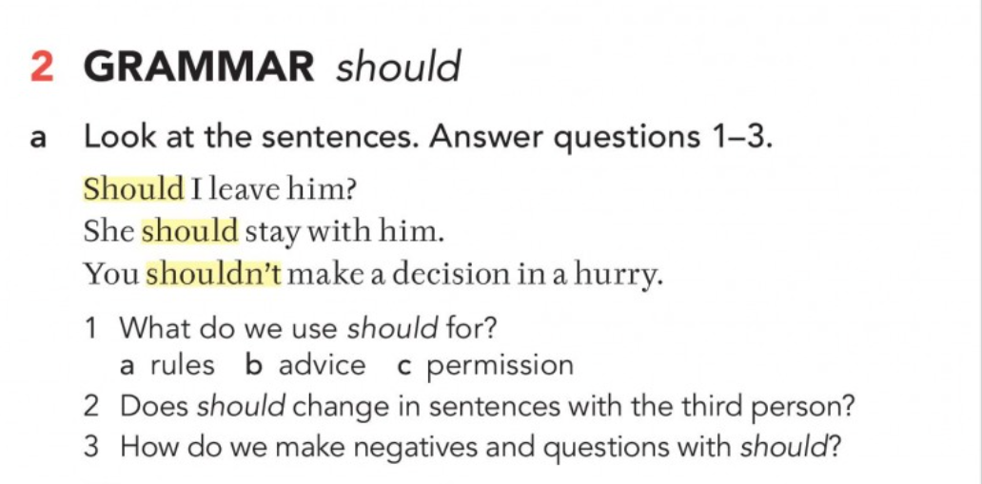
2 No (ex: She should stay with him)
3 NEGATIVES with should:
Add not / n’t
3 QUESTIONS
Should + subject + infinitive

Slide 14
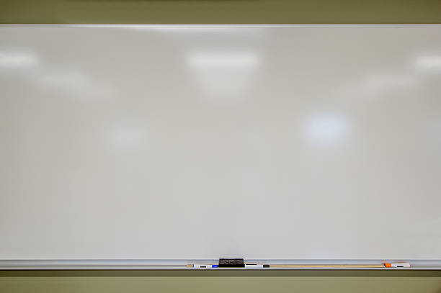
Grammar lesson on the board

Slide 15
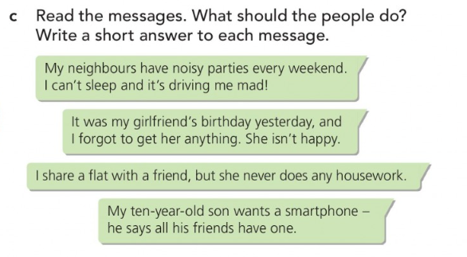

Slide 16

*It’s driving me mad/crazy =
To make someone very angry or upset

Slide 17
10-20 words for each message (do it alone!)

Slide 18

1 Read your advice to your partners.
2 Choose the best piece of advice!

Slide 19
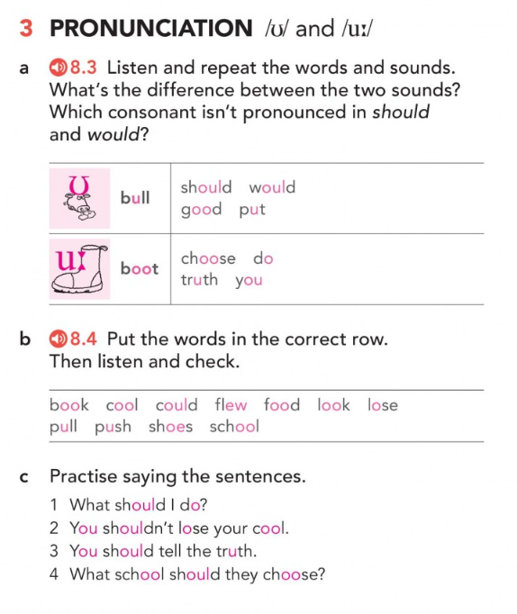
/ʊ/ is short; /uː/ is long.
The l isn’t pronounced in should and would.
NOW, listen and repeat.

Slide 21
push
could
book
look
pull
flew
cool
shoes
lose
food
school

Slide 22
Practice saying the sentences with your partner.

Slide 23
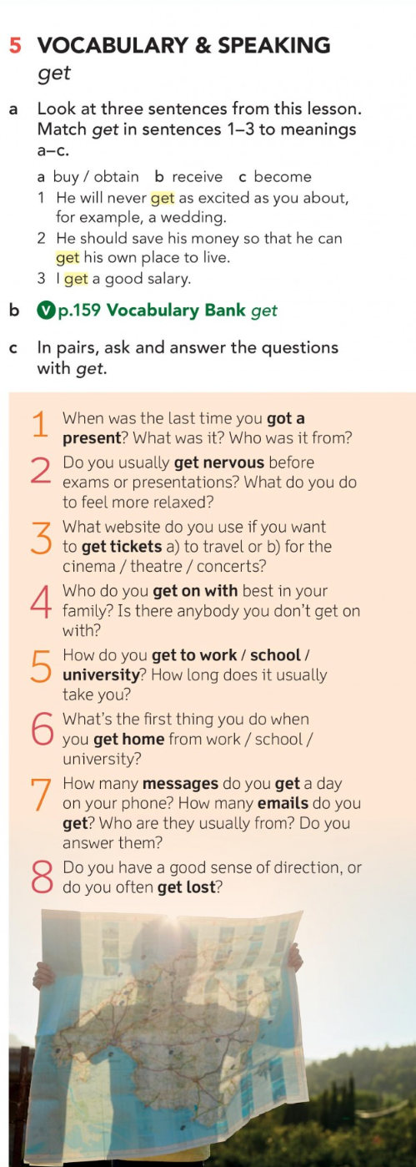

Slide 24


Slide 25
p.54: 1A GRAMMAR should)
2. shouldn’t drink
7. should call
3. should go
A3
E6
4. should see
B4
F2
C1
5. should tell
G5
D7
6. shouldn’t give

Slide 26
p.54: 1B GRAMMAR should
2. should wear
3. shouldn’t buy
4. should visit
5. shouldn’t have
6. should get

Slide 27
p.54: 2A PRONUNCIATION
2. could
3. soup
4. book

Slide 28

Advice (noun)
(verb) : ?
(to) advise

Slide 29
(to) ask ………… help
for

Slide 30
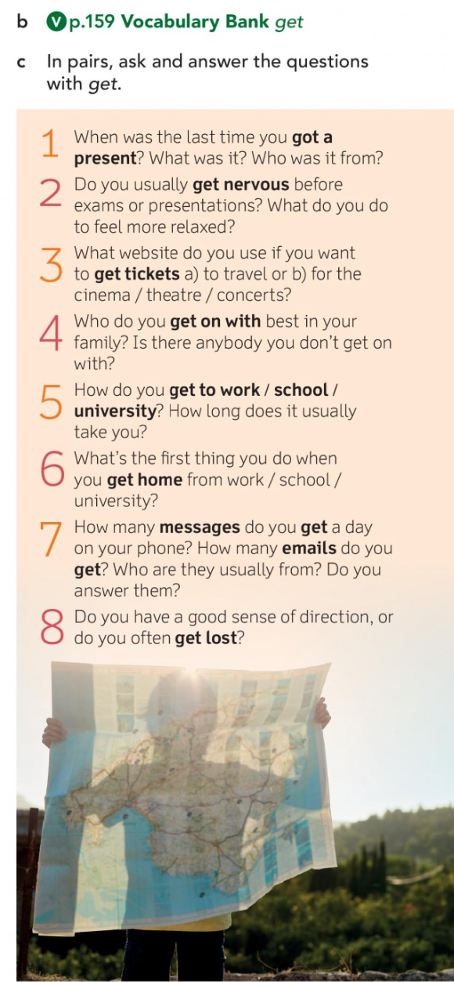
receive
become
obtain
transport
arrive
receive
become
Talk to your partner. Ask and answer the questions.

Slide 31

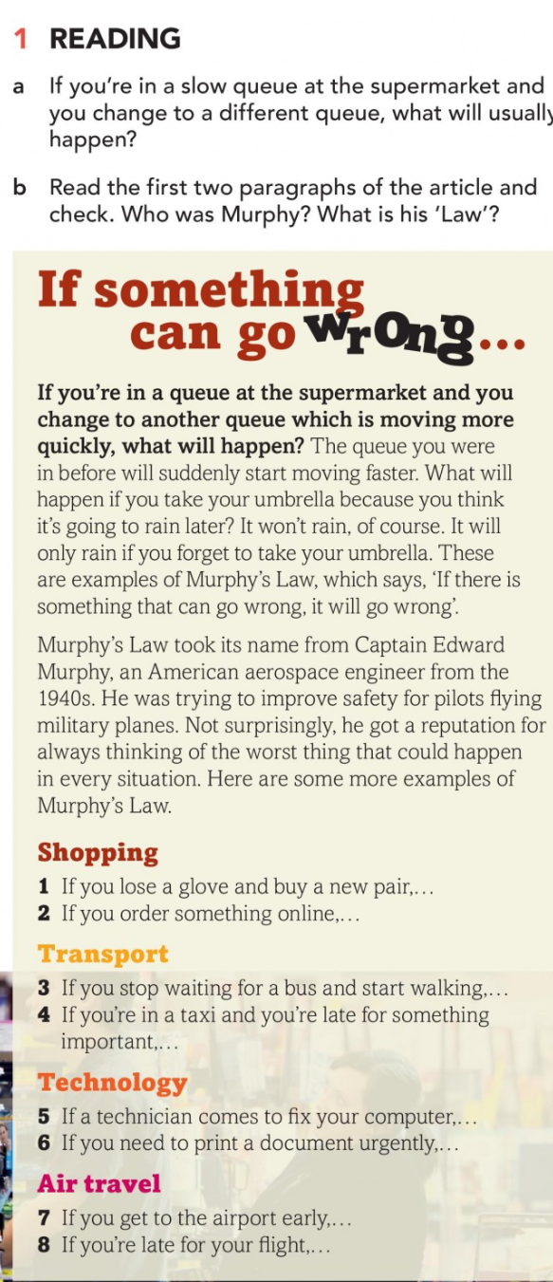
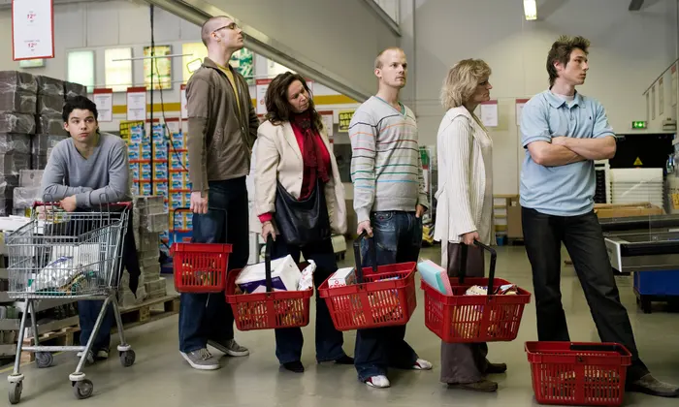
queue (n)

Slide 32
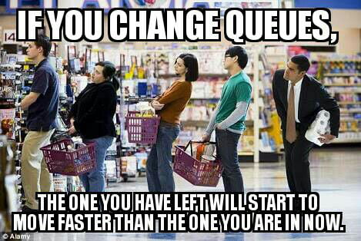
The queue we were in before will move faster.

Slide 33

*Who was Murphy?
*What is his ‘Law’?

Slide 34
ANSWER:
Murphy was an American aerospace engineer.
His 'Law’ is ‘if there is something that can go wrong, it will go wrong.’

Slide 35
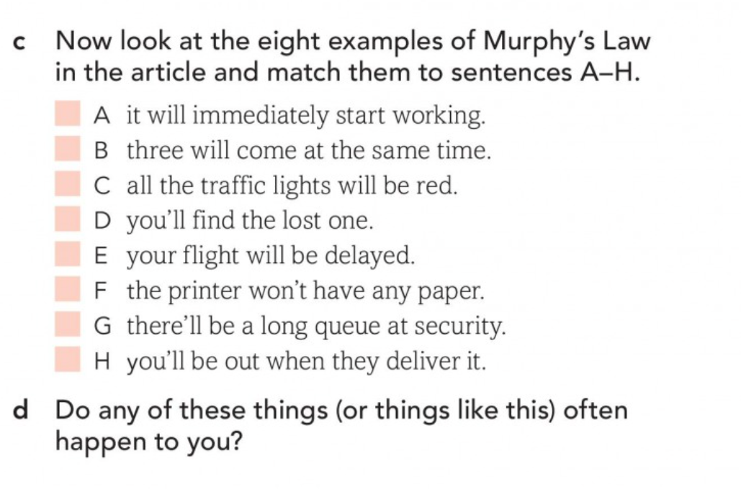
5
3
4
1
7
6
8
2

Slide 37
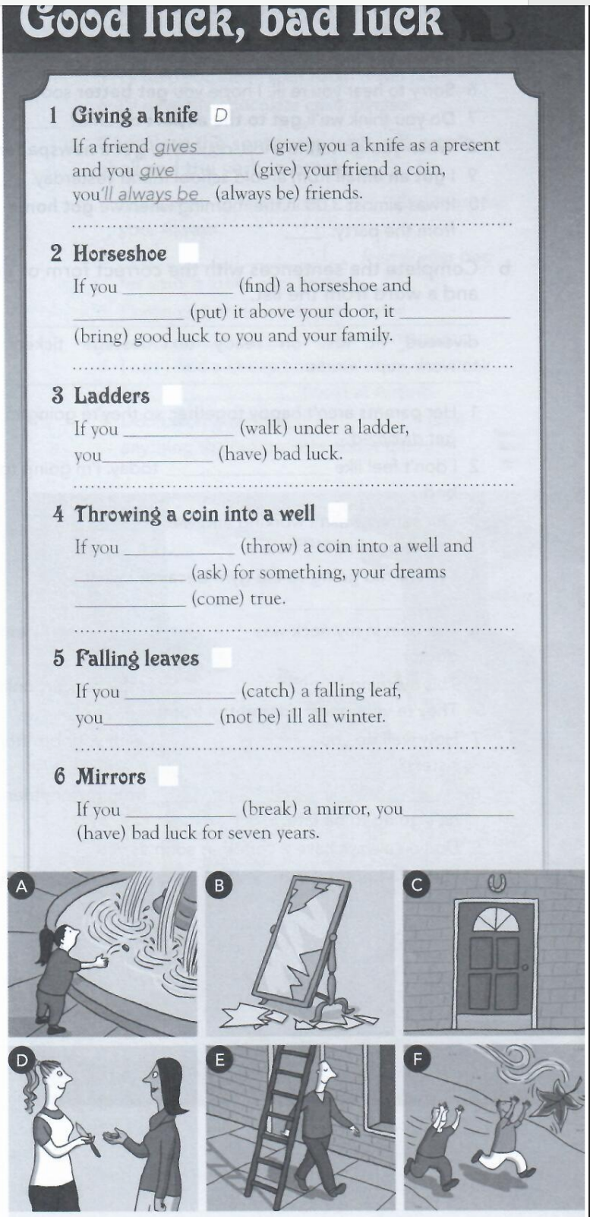
2 find – put - will bring/’ll bring
3 walk - will have
4 throw – ask - will come/’ll come
5 catch – won’t be/will not be
6 break – will have/’ll have

Slide 38
Homework 2: 8B, b) p. 141
6. will miss/’ll miss – move
1. tell – will not tell/won’t tell
7. listen – will understand/’ll understand
2. don’t write- won’t remember/will not remember
8. will not be/won’t be - are
3. will… call – get
9. will drive/’ll drive - give
4. will help/’ll help – ask
10. don’t take – will rain/’ll rain
5. will phone/’ll phone – hear

Slide 39
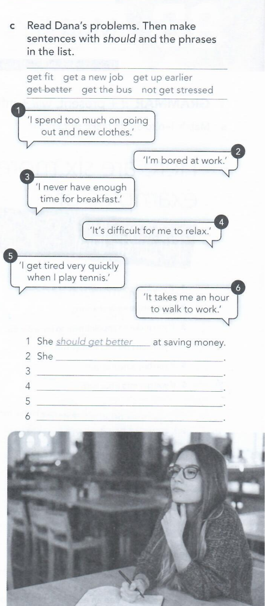
Homework 2: 3c) p. 55
2 She should get a new job.
3 She should get up earlier.
4 She shouldn’t get stressed.
5 She should get fit.
6 She should get the bus.

Slide 40
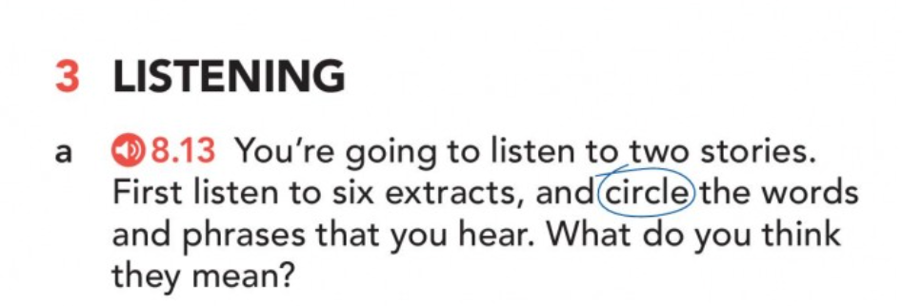
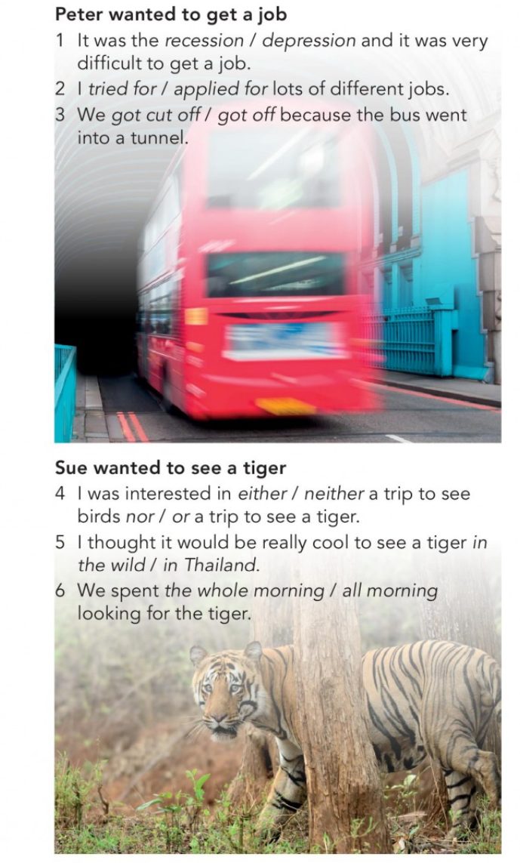


Slide 41
1 recession
2 applied for
3 cut off
4 either… or
5 in the wild
6 the whole morning

Slide 42
What do these words mean?
Talk to your partner.

Slide 43
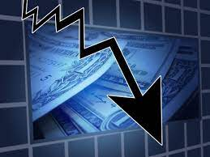
recession (n)
= a difficult time for the economy of a country

Slide 44
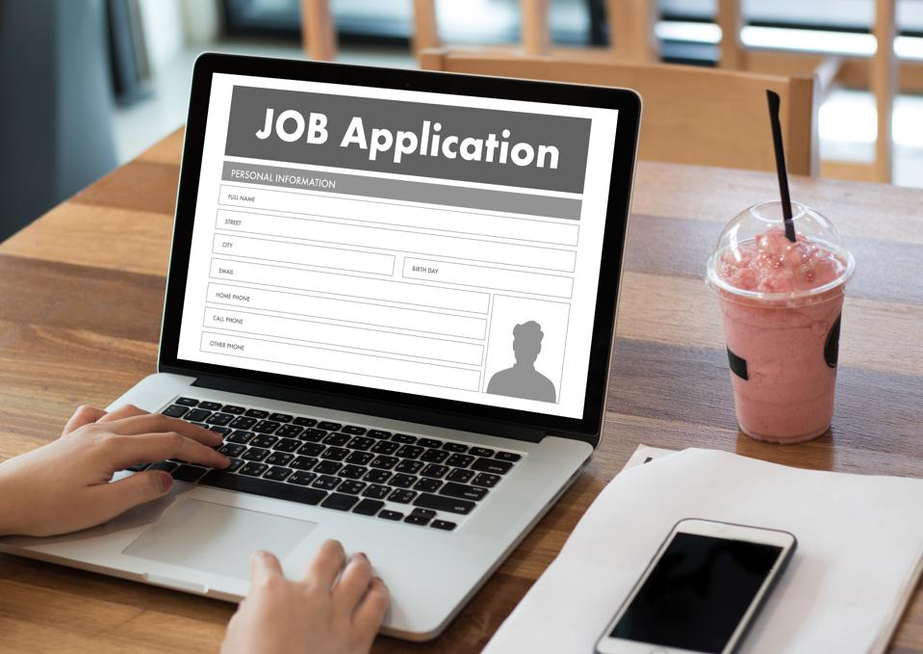
apply for (v)
= send CVs/
applications to employers to find a job

Slide 45

cut off (v)
= lost phone connection

Slide 46

either…
… or
a trip to see birds
a trip to see tigers

Slide 47
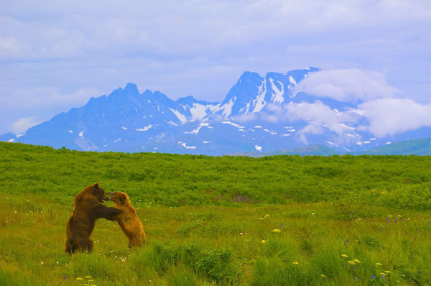
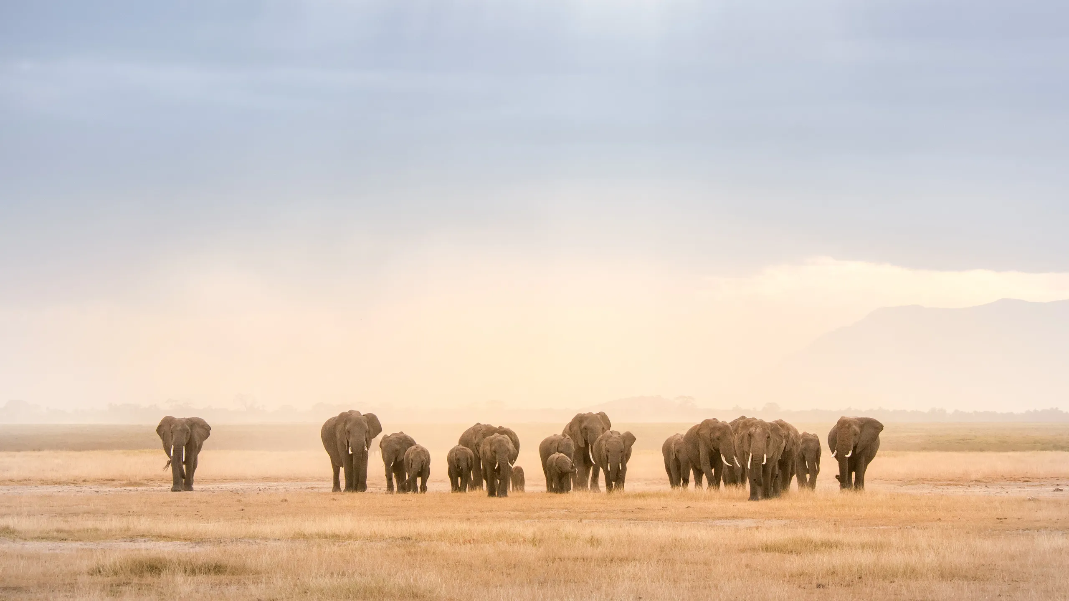
in the wild (n)
= the nature

Slide 48
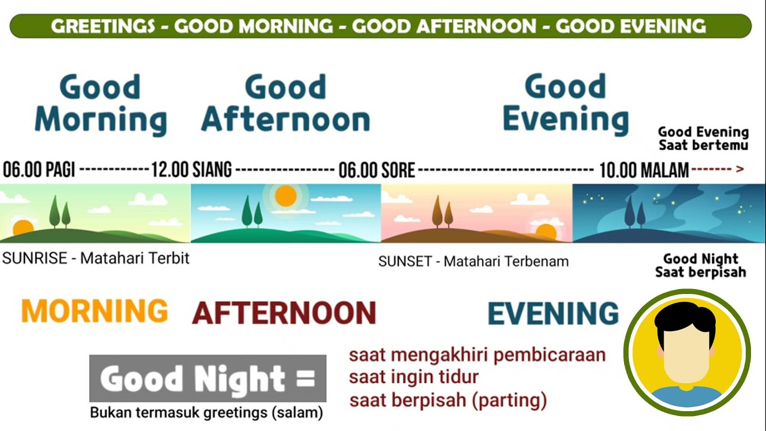
= all morning
the whole (adj) morning

Slide 49
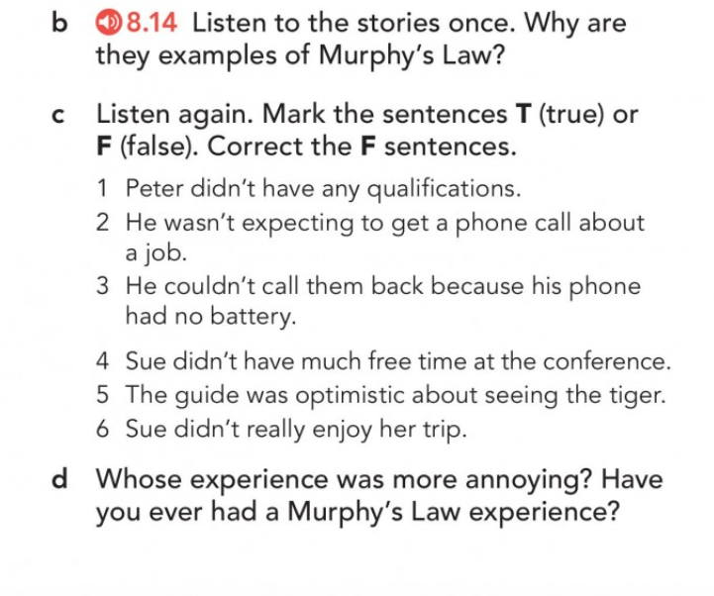
Peter waited four months for a job interview, but when the phone call finally came for an interview, the call got cut off.
Sue got up early for a trip to see a tiger, but didn’t see one. However, other people who went on a trip to see birds saw the tiger.

Slide 50
True or False?
Correct the False sentences.

Slide 51
F = Peter did maths at university
T
F = because his phone said ‘unknown number’.
T
F = the guide wasn’t optismistic
F = she enjoyed

Slide 52
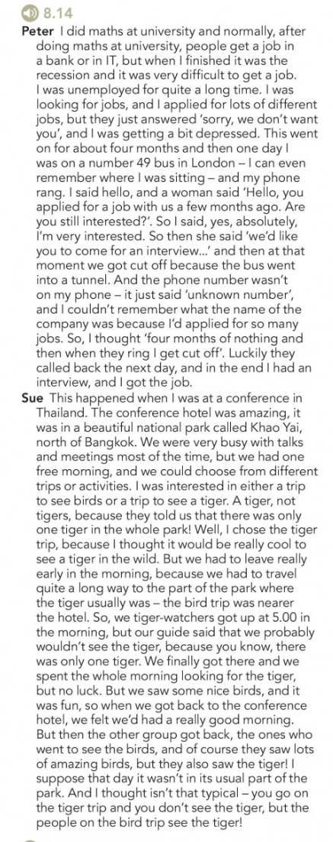
Listen again with the script p.124.

Slide 53
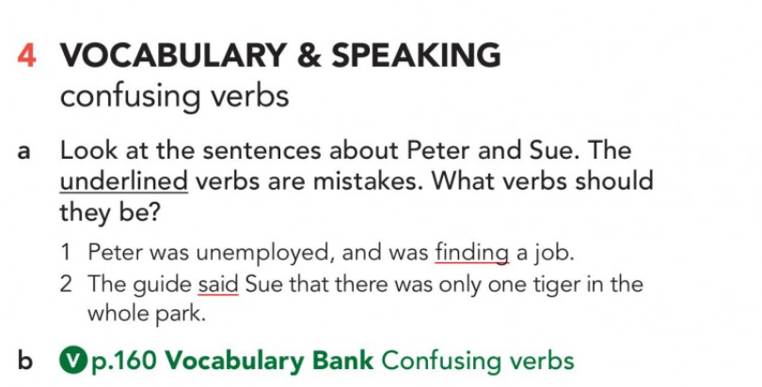
looking for
told

Slide 54
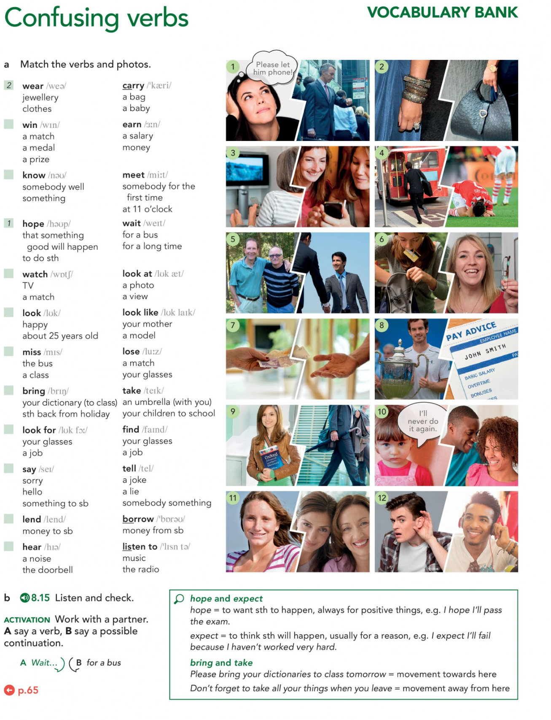
Do it individually or with your partner.

Slide 56
Listen and check.

Slide 57


Slide 58
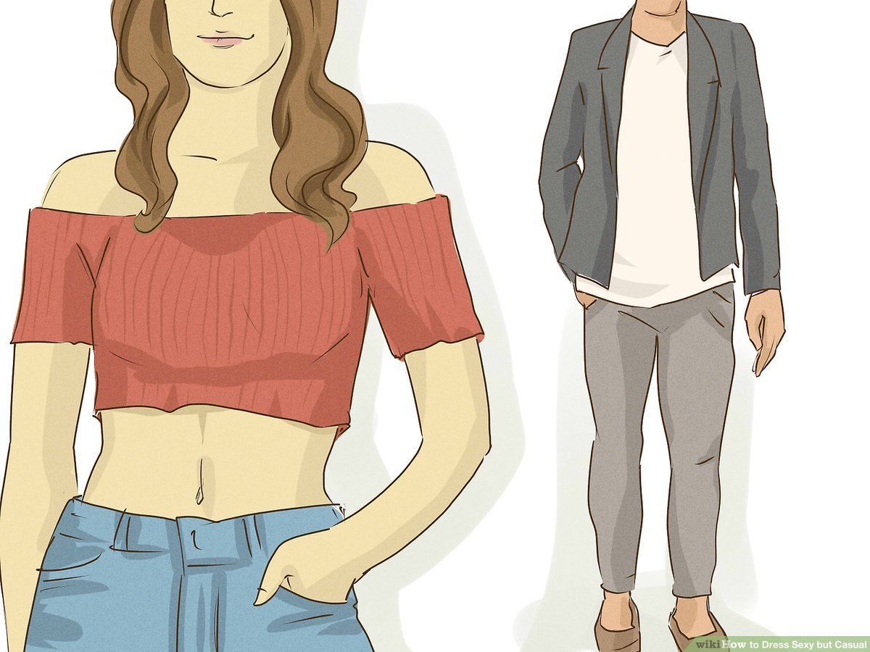
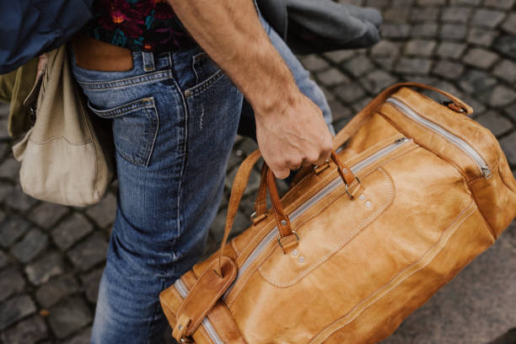
wear (v)
carry (v)

Slide 59


win (v)
earn (v)

Slide 60

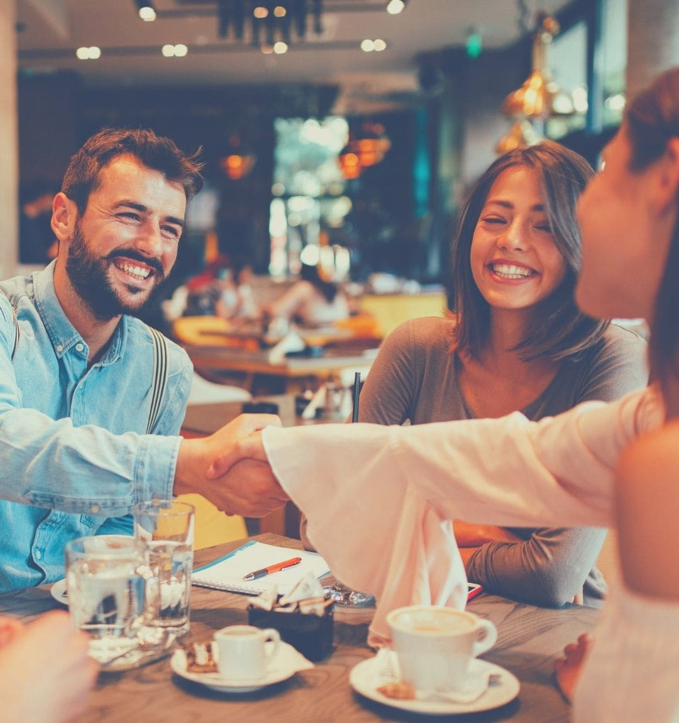
know (v)
meet (v)

Slide 61
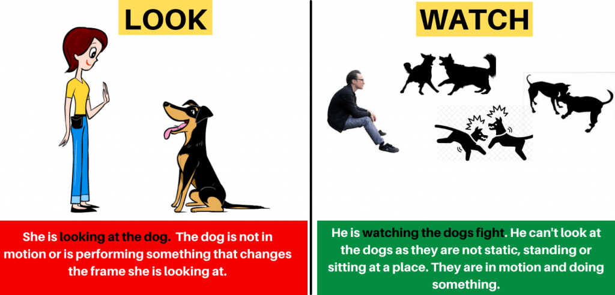

Slide 62
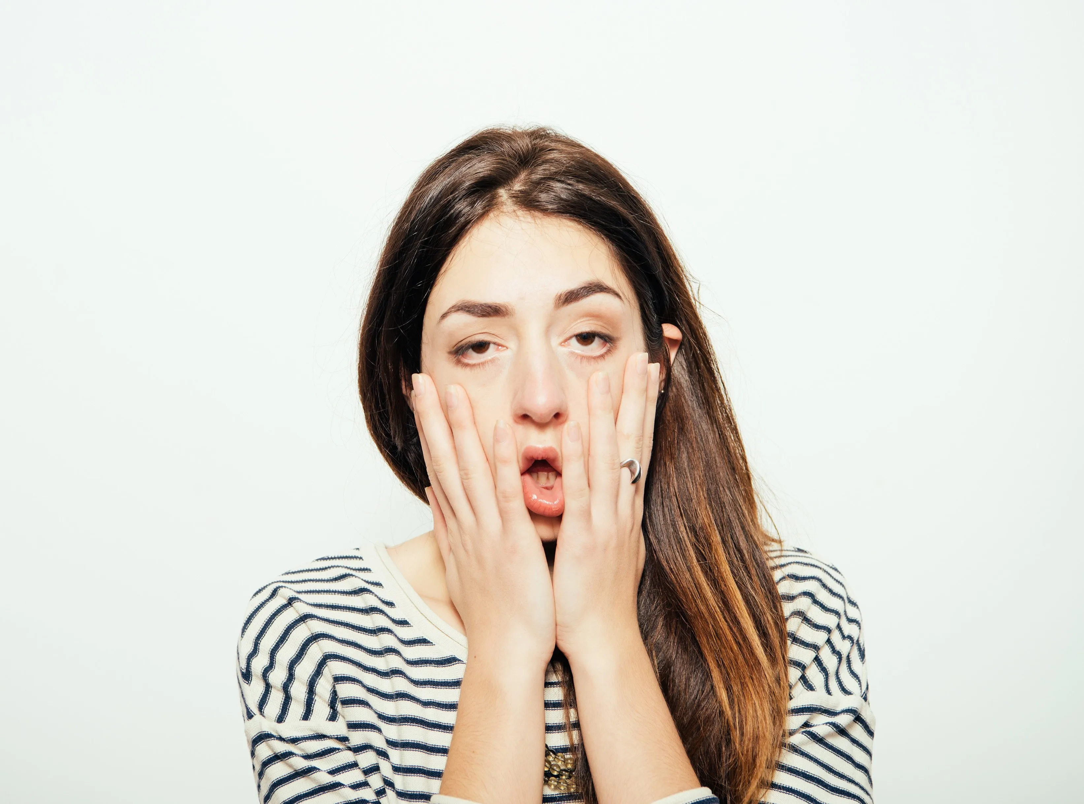
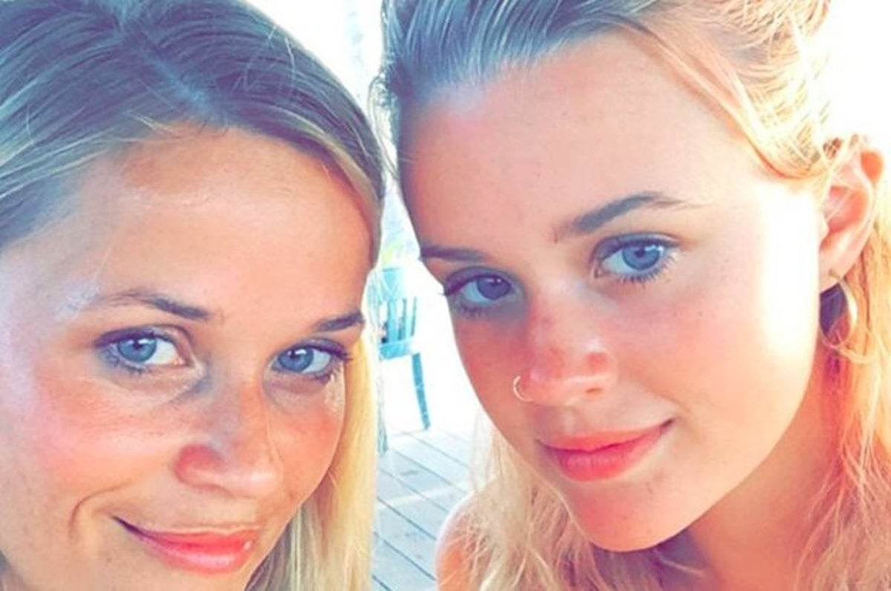
look (v) + adj = how something/someone eppears
look like + noun = to compare the appearance of people/things
°
Ex: You look like your mother!
Ex:
You look tired today.

Slide 63
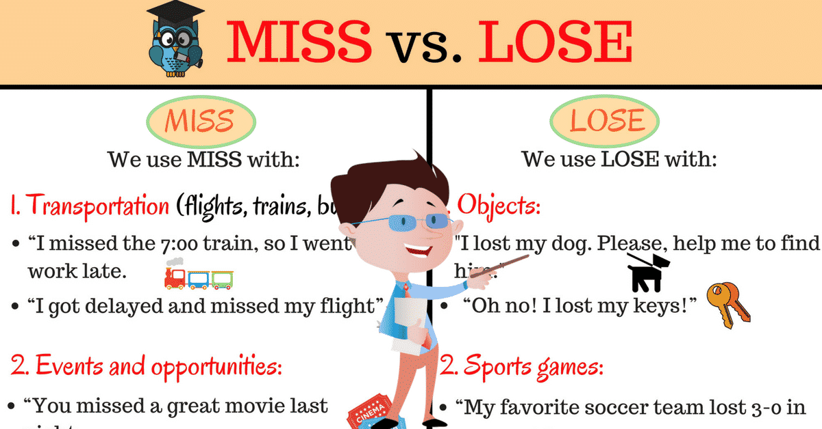

Slide 64
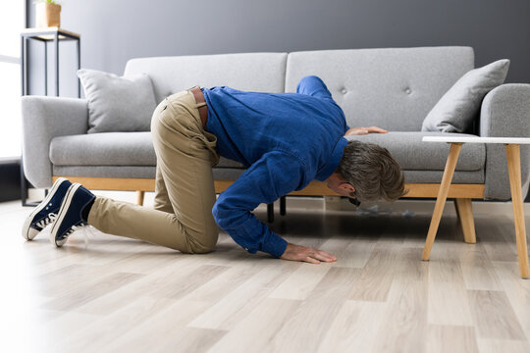

find (v)
look for (v) = search for (v)

Slide 65
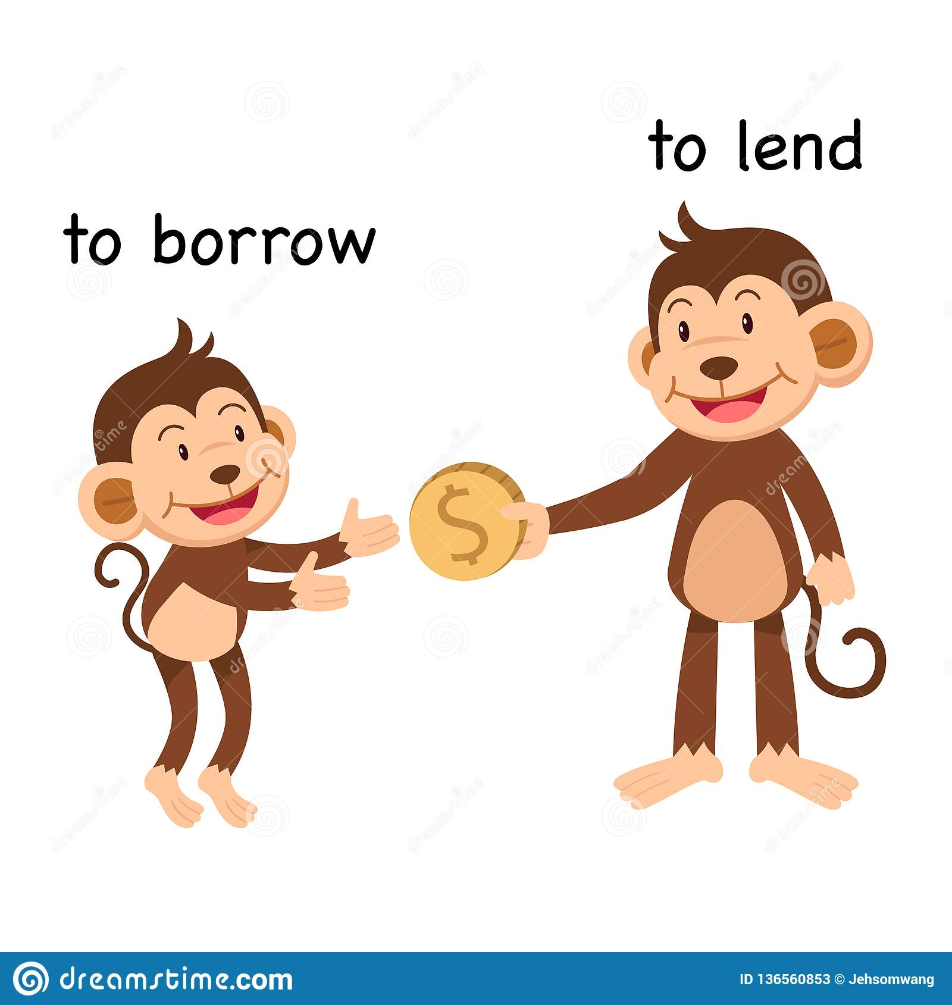
money from someone
money
to someone

Slide 66
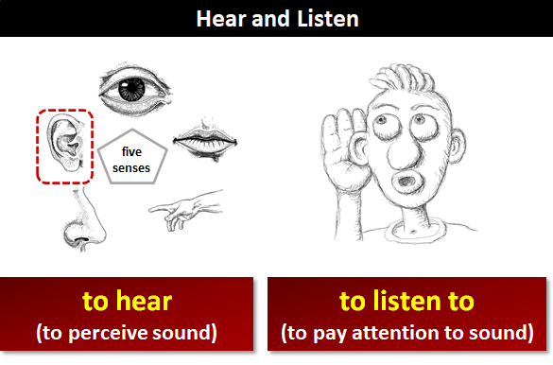

Slide 67
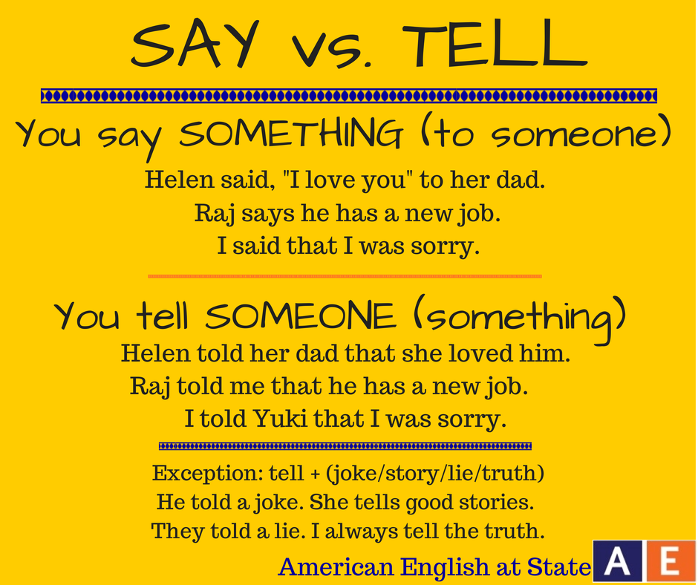

Slide 68
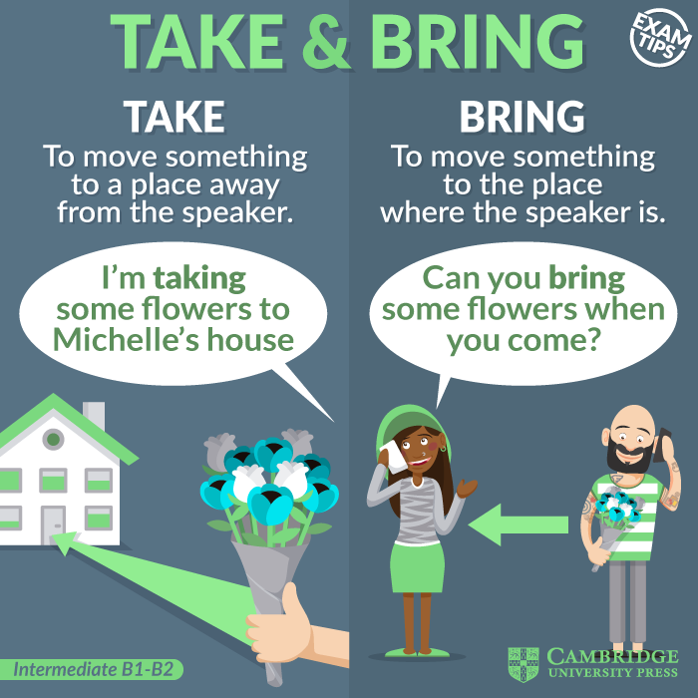
It depends on where the speaker is.

Slide 69
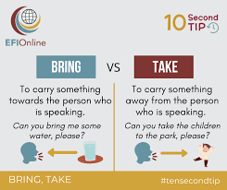

Slide 70
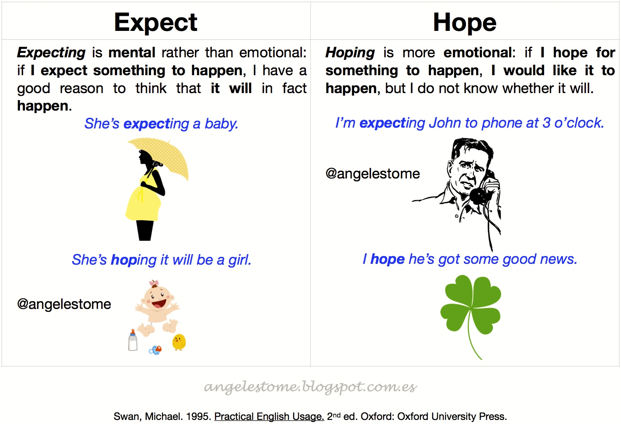

Slide 71
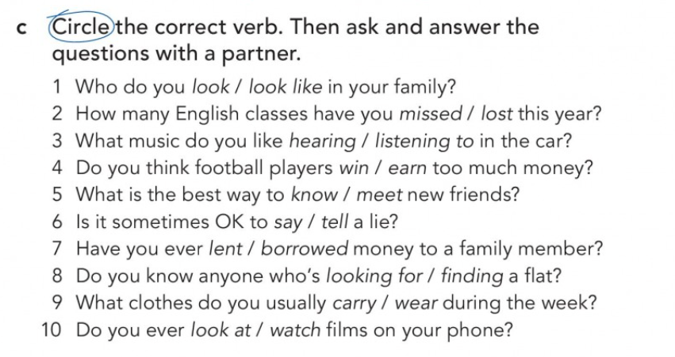

Slide 72
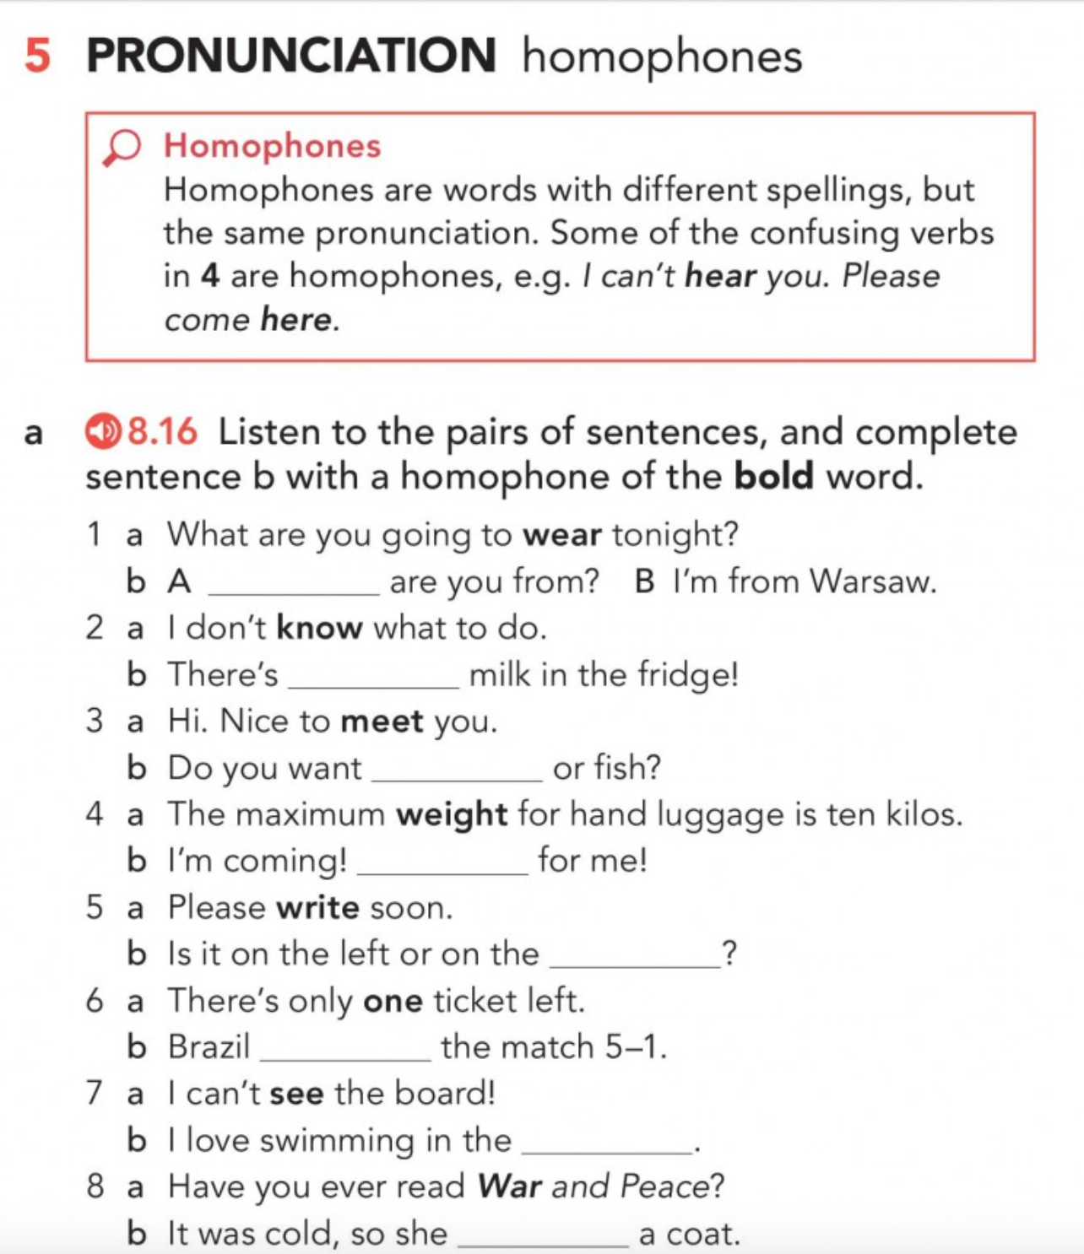
1 Where
2 no
3 meat
4 wait
5 right
6 won
7 sea
8 wore

Slide 73
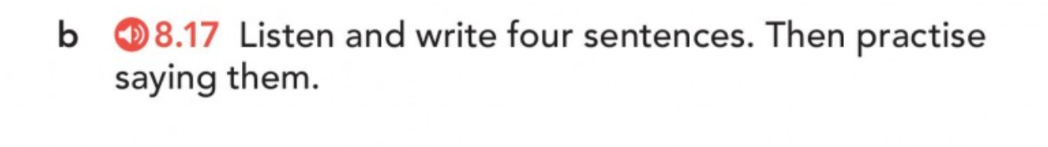

First listening: DON’T WRITE. JUST LISTEN!
Second listening: Time to write!

Slide 74
1 I can see the sea from here.
2 I write with my right hand.
3 He won one game. 4 I know there’s no hope.

Slide 75
Practice saying the sentences with your partner.
1 I can see the sea from here.
2 I write with my right hand.
3 He won one game. 4 I know there’s no hope.

Slide 77

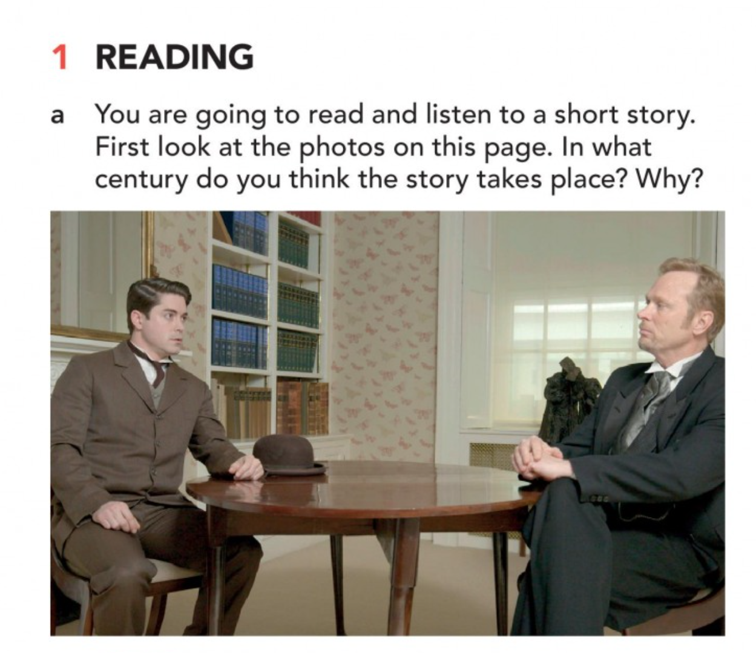
costumes
19th century?

Slide 78
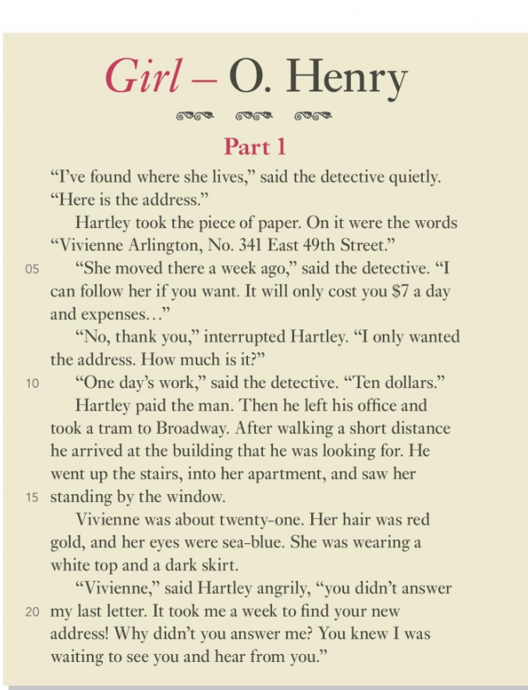
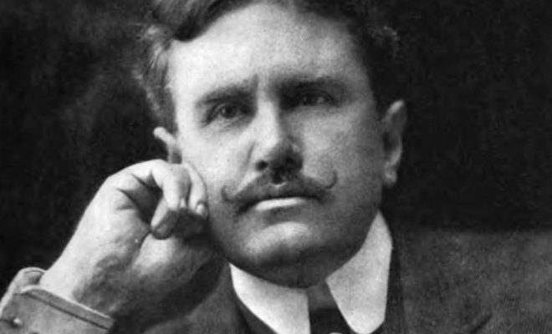
Real name = William Sydney Porter (1862-1910)
Famous American author

Slide 79
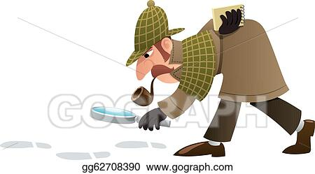
detective (n)

Slide 80

a piece of paper

Slide 81

expenses (n, pl.) = cost

Slide 82

take (v) a tram (19th century)

Slide 83

Go (v) up the stairs

Slide 84

stand (v) by the window

Slide 85

hear (v) from someone
If you hear from someone, you get a letter, email, or phone call from that person.

Slide 86



Slide 87
Read Part 1 again with NO AUDIO.
In pairs, answer the questions 1 to 4 and the ‘Think about the story so far’.

Slide 88
ANSWERS:
1 He gave Hartley Vivienne’s address. He offered to follow her.
3 She looked about 21, her hair was red gold, and her eyes sea- blue.
2 He left the detective’s office and went to find where Vivienne lived.
4 Because she didn’t answer his letter.

Slide 89

Vocabulary before reading Part 2:

Slide 90



Slide 91
Read Part 2 again with NO AUDIO.
In pairs, answer the questions 1 to 4 and the ‘Think about the story so far’.

Slide 92
ANSWERS:
1 She doesn’t think she would enjoy living in the suburbs.
2 He told her she could come to the city whenever she wants.
3 At the Montgomerys’.
4 Because she has someone else.

Slide 93

Focus on the last four lines of the story Part 2 (from “Vivienne,” said Hartley masterfully to the end).

Slide 94
ANSWERS:
a punctuation
b the adverbs, i.e. masterfully, calmly

Slide 96


Slide 97

my
mine

Slide 98
Grammar lesson on the board

Slide 99


Slide 100

Hers
him
their
ours
theirs
us
our
its

Slide 101

Listen to seven sentences, and each time, you must change the object for a possessive pronoun.

Slide 102
ANSWERS:
1 It’s my book. (pause) It’s mine. 2 It’s her scarf. (pause) It’s hers. 3 They’re our coats. (pause) They’re ours. 4 It’s his bike. (pause) It’s his. 5 It’s your phone. (pause) It’s yours. 6 It’s their house. (pause) It’s theirs. 7 They’re your sweets. (pause) They’re yours.

Slide 103


Slide 104


Slide 105


Slide 106


Slide 107
ANSWERS:
2 She promised Hartley she would be his.
1 He said Héloise must go.

Slide 108


Slide 109

ANSWERS:
1 Hartley’s wife
2 The Montgomerys’ cook
3 Hartley’s cook

Slide 110
Watch the video Part 4 again with subtitles.
See exactly what you understood / didn’t understand.

Slide 111


Slide 112
An adverb of manner describes how you do an action. They follow immediately after a verb.
Ex: They dress elegantly.
He shouted angrily.
Some elderly people drive slowly.

Slide 113

describe actions (they follow verbs)

Slide 115
ANSWERS:
dreamily (line 24)
slowly (line 25)
completely (line 35)
suddenly (line 43)
masterfully (line 49)
calmly (line 51)

Slide 116
Lazy = lazily
angry = angrily
lazy = lazily
quiet = quietly
sad = sadly
serious = seriously
slow = slowly

Slide 117

sadly
angrily
slowly
quietly
lazily
seriously

Slide 118


Slide 119


Slide 120
Subject + MUSTN’T + base verb
=
INTERDICTION

Slide 121



Slide 122


Slide 123


Slide 124


Slide 125
Subject + DON’T HAVE TO or DOESN’T HAVE TO (he/she/it) + inf
= NO OBLIGATION, NOT NECESSARY

Slide 126

NO obligation =
not necessary

Slide 127

I can cook if i want to, but it is not an obligation = not necessary

Slide 128

You don’t have to wear a uniform at school if you don’t want to. =
No obligation to wear a uniform

Slide 129
Subject + MUST + base verb
=
1) Personal obligation
2) Giving rules/instructions to another person

Slide 130

You must clean your room!
Obligation from parent to child)

Slide 131

Obligation from teacher to student)

Slide 132

Personal obligation

Slide 133

I must stop smoking! = I take the decision to stop smoking because I know it’s not healthy for me.
= PERSONAL OBLIGATION

Slide 134
Subject + HAVE TO or HAS TO (he, she, it) + base verb
=
1 General/external obligation (ex: school/work rules, law)
2) Obligation to do something by another person

Slide 135

I have to start school at 9am. =
SCHOOL RULES

Slide 136

In Australia, you have to drive on the right.
= it’s the law

Slide 137

I have to stop smoking?
You must stop smoking!

Slide 138


Slide 139


1 a
2 c
3 b
4 c
5 b
6 a
7 a
8 c
9 c
10 b
11 a
12 b
13 b
14 c
15 b

Slide 140


Slide 141

forget
learn
feel like
promise
hate
mind
enjoy
finish

Slide 142

with
in
of
at
for

Slide 143

ost
ome
etter
ickets
n
ivorced
esents

Slide 144


Slide 145



Slide 146

c
a
f
e
b
d

Slide 147

b
c
b
c
a

Slide 148


